Slide 1


Pipeline Forecasting Model V6
TWO-LAYER HYBRID ARCHITECTURE
January 2026 | Strategic Planning

Slide 2


Executive Summary
Two-Layer Hybrid Model
This project implements a robust forecasting model designed to handle sparse data in high-value segments, specifically the Large Market. It blends historical stability with recent performance trends.
•
Goal: Produce a stable, defensible forecast for 2026.
•
Mechanism: Combines cohort-based vintage analysis (Layer 1) with stage-weighted probability modeling (Layer 2).
•
Outcome: A forecast within 14% of 2025 actuals, representing a realistic recovery target.

Slide 3


Methodology & Architecture
Layer 1: Future Pipeline
Layer 2: Active Pipeline
The "When"
The "How Much"
Forecasts revenue from deals not yet created in 2026.
Forecasts revenue from deals currently open as of year-end 2025.
•
Uses T12M average monthly deal creation volume.
•
Stability Anchor: Anchors to 50/50 blend of T12M and All-Time if volume drops >30%.
•
Assigns probability based on current stage.
•
Credibility Weighting: Blends specific win rates with global averages if exits < 50.
•
Timing uses a blended distribution (50% All-Time / 50% Recent).
•
Staleness Penalty (0.8x) applied to deals >95th percentile age.

Slide 4
Scenario B: Growth Recovery Inputs
The forecast is driven by three primary levers applied at the segment level. Scenario B assumes a recovery in deal volume and conversion efficiency.
Segment | Volume Multiplier | Win Rate Multiplier | Deal Size Multiplier
Large Market | 1.8x | 1.4x | 1.2x
Indirect | 1.4x | 1.2x | 1.1x
Mid Market | 1.4x | 1.2x | 1.0x
SMB | 1.4x | 1.1x | 1.0x
Other | 1.0x | 1.0x | 1.0x

Slide 5



FY26 Forecast Summary
$19.63M
14%
600
Total Revenue
Variance to 2025
Approx Deal Count
Target for FY26
vs $22.8M Actuals
Across all segments
The forecast projects a conservative yet realistic recovery. The 14% variance vs 2025 actuals accounts for market corrections while targeting growth in key segments.

Slide 6
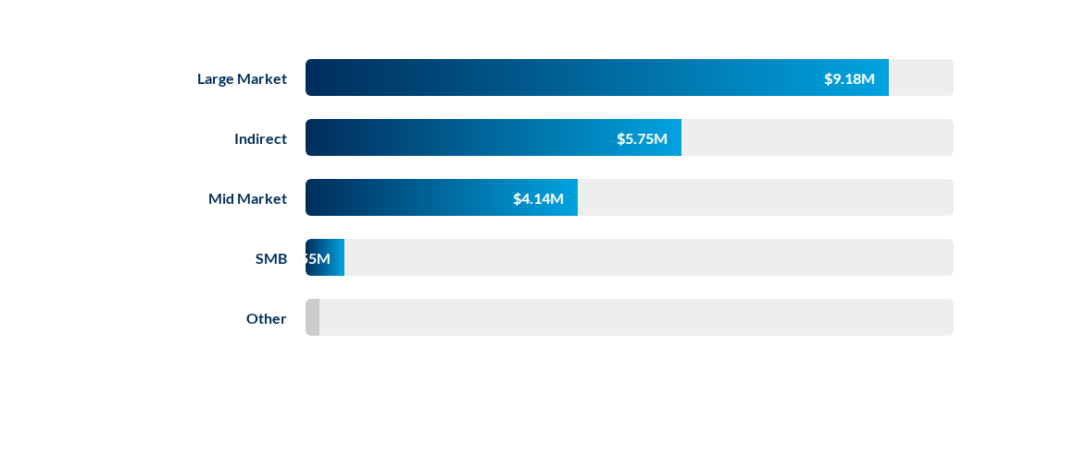
Revenue by Segment
Large Market remains the primary revenue driver, contributing ~47% of the total forecast.

Slide 7
Model Validation (2025 Backtest)
The model was validated by predicting 2025 performance using data available as of Jan 1, 2025.
Segment | Forecast | Actuals 2025 | Variance | Status
Large Market | $7.78M | $8.12M | -4.2% | ✅ Excellent
Indirect | $5.93M | $7.84M | -24.3% | ⚠️ Under
Mid Market | $4.48M | $6.45M | -30.5% | ⚠️ Under
Total | $18.34M | $22.82M | -19.7% | ✅ Acceptable

Slide 8






Logic Deep Dive: Stability Mechanisms
Stability Anchors
Credibility Weighting
Staleness Penalty
If 2025 volume drops >30% vs all-time history, the model anchors to a 50/50 blend of T12M and All-Time data to prevent over-correction.
For segment/stage combos with <50 exits, we blend specific win rates with global averages to avoid unrealistic zero-probabilities.
A 0.8x multiplier is applied to deals older than the 95th percentile duration to reflect diminishing close probability.

Slide 9

Strategic Insights
Large Market Stability
The backtest variance of only -4.2% in the Large Market segment validates the new "Credibility Weighting" logic. This stability is crucial as Large Market deals drive nearly half of our forecasted revenue.
Areas for Adjustment
Indirect and Mid Market segments were under-forecasted in the backtest (-24% and -30%). The V6 model incorporates aggressive "Growth Recovery" multipliers (1.4x Volume) in these segments to close the gap.

Slide 10




V7 Roadmap & Enhancements
Seasonality
Attribution
Velocity
Churn
Adding quarterly weighting (e.g., Q4 flush) to improve monthly precision.
Differentiating Marketing-sourced vs. Sales-sourced leads for Layer 1.
Incorporating time-in-stage metrics for dynamic "Staleness" penalties.
Adding churn/contraction modeling to move towards Net Revenue forecasting.

Slide 11
Questions?
Pipeline Forecasting Model V6
Forecasting Team | January 2026

Slide 12



Image Sources
https://curalinc.com/hubfs/CuraLinc_Primary-Logo_RGB_Color_Transparent_3x.png
Source: curalinc.com
https://img.freepik.com/premium-vector/business-team-analyzing-data-large-screen_1058841-1199.jpg
Source: www.freepik.com
https://static.vecteezy.com/system/resources/previews/060/263/189/non_2x/abstract-business-background-transparent-growth-chart-and-arrow-progress-financial-success-concept-vector.jpg
Source: www.vecteezy.com

